Slide 1
Types of Fibers

Slide 2
TYPES OF OPTICAL FIBers
On the basis of variation of RI of core, the optical fibers are mainly classified into following types. i.e.,
1.Step Index fiber 2.Graded Index fiber
Based on Mode of propagation, the fibers are further divided into
1. Single Mode 2.Multi -Mode.

Slide 3
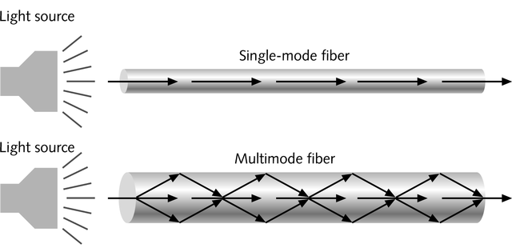
Single and Multi-mode Fiber
Single-mode fiber
  Carries light pulses along single path
  Uses Laser Light Source
Multimode fiber
  Many pulses of light generated by LED travel at different angles

Slide 4
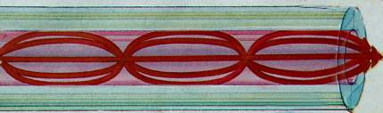
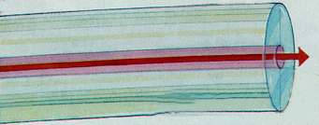
Multimode fiber
Single Mode fiber

Slide 5
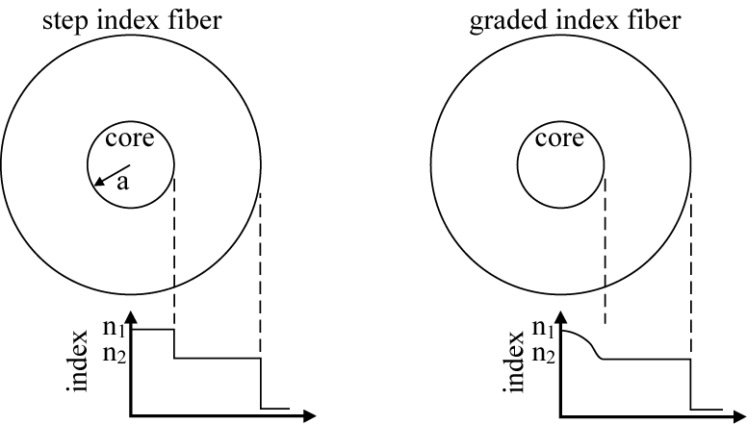
Refractive index discontinuity at core-clad boundary
Refractive index gradually deceases as we move away from the center of the core material.

Slide 6
Single Mode Step Index fiber
The RI is constant for the core in this fiber. As we go radially from center of the core, the RI undergoes a step change at core-cladding interface .
The core diameter of this fiber is about 8 to 10µm and the outer diameter of cladding is 60 to 70µm.
There is only one path for light ray propagation. Hence it is called single mode step index fiber.
It is a reflective fiber since light is transmitted from one end to the other end of a fiber by TIR.
These are extensively used because distortion and transmission losses are very less.

Slide 7
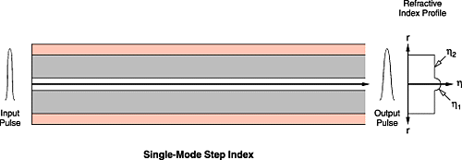
Single-Mode Step Index Fiber
The Core diameter is 8 to 9μm
All the multiple-mode or multimode effects are eliminated
However, pulse spreading remains
Bandwidth range is large.
Lecture 3

Slide 8
Refractive index profile of
single mode step index fiber
60 to 70 µm
8 to 10 µm
RI
Radial distance

Slide 9
Propagation in SINGLE MODE STEP INDEX FIBER
CLADDING
CORE
CLADDING

Slide 10
Multimode Step Index Fiber
The construction of this fiber is similar to Single mode step index fiber but dimensions of Core and Cladding are much larger to have more number of paths for light propagation.
The Core diameter varies from 50 to 200µm and the Cladding diameter varies from 100 to 250µm.
It is also a reflective fiber since light is propagated in the form of multiple TIRs.

Slide 11
REFRACTIVE INDEX PROFILE OF MULTI MODE STEP INDEX FIBRE
100 to 250 µm
50 to 200 µm
RI
Radial distance

Slide 12
GRADED INDEX FIBRE
In this fiber , the RI of Core continuously decreases from center to the surface (radially).
The RI is maximum at the center of Core and Minimum at the Surface.
This fiber can be a single mode or Multimode ,the diameters of core and cladding varies from 50-200µm and 100-250µm respectively.

Slide 13
REFRACTIVE INDEX PROFILE OF GRADED INDEX FIBer
100 to 250 µm
50 to 200 µm
RI
Radial distance

Slide 14
As RI changes continuously radially in Core, the light rays suffers continuous refraction with in the Core from its center to surface.
Thus the propagation of light rays are not due to TIR but by refraction. Therefore it is called Refractive fiber.
In this fiber, the light rays travel at different speeds in different parts.
Near the surface RI is least so, the light rays travel faster compared to the light rays near the axis. Because of this all the rays almost arrive at the same time at the other end of the fiber----They follow different paths.

Slide 15
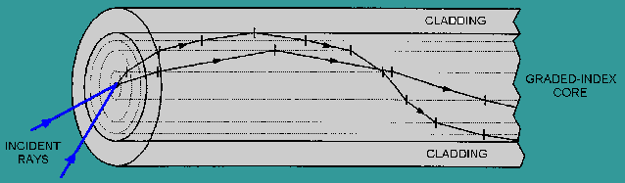
LIGHT PROPAGATION IN MUTI-MODE
GRADED INDEX Fiber
CLADDING
CORE

Slide 16
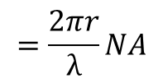




Normalized or Cut-off Frequency
Single-Mode Fiber
V<2.405
Multimode-Mode Fiber
V>2.405
N
Number of Modes Generated Inside a Fiber
N=
Step-Index Fiber
N=
Graded-Index Fiber

